Slide 1
Comparison and Contrast between the OSI and TCP/IP Model

Slide 2
Introduction
This presentation would discuss some comparison and contrast between the 2 main reference models which uses the concept of protocol layering.
Open System Interconnection Model (OSI)
Transport Control Protocol /Internet Protocol (TCP/IP)

Slide 3
Introduction
The topics that we will be discussing would be based on the diagram below.
OSI
TCP / IP
Application (Layer7)
Application
Presentation (Layer6)
Session (Layer 5)
Transport (Layer 4)
Transport
Network (Layer 3)
Internet
Data Link (Layer 2)
Subnet
Physical (Layer 1)

Slide 4
Outline
Compare the protocol layers that correspond to each other.
General Comparison
  Focus of Reliability Control
  Roles of Host system
  De-jure vs. De-facto

Slide 5
The Upper Layers
OSI
TCP / IP
Application (Layer7)
Application
Presentation (Layer6)
Session (Layer 5)
Session
Presentation
Application

Slide 6
The Session Layer
The Session layer permits two parties to hold ongoing communications called a session across a network.
Not found in TCP/IP model
In TCP/IP,its characteristics are provided by the TCP protocol.
(Transport Layer)

Slide 7
The Presentation Layer
The Presentation Layer handles data format information for networked communications. This is done by converting data into a generic format that could be understood by both sides.
Not found in TCP/IP model
In TCP/IP, this function is provided by the Application Layer.
e.g. External Data Representation Standard (XDR)
Multipurpose Internet Mail Extensions (MIME)

Slide 8
The Application Layer
The Application Layer is the top layer of the reference model. It provides a set of interfaces for applications to obtain access to networked services as well as access to the kinds of network services that support applications directly.
OSI - FTAM,VT,MHS,DS,CMIP
TCP/IP - FTP,SMTP,TELNET,DNS,SNMP
Although the notion of an application process is common to both, their approaches to constructing application entities is different.

Slide 9
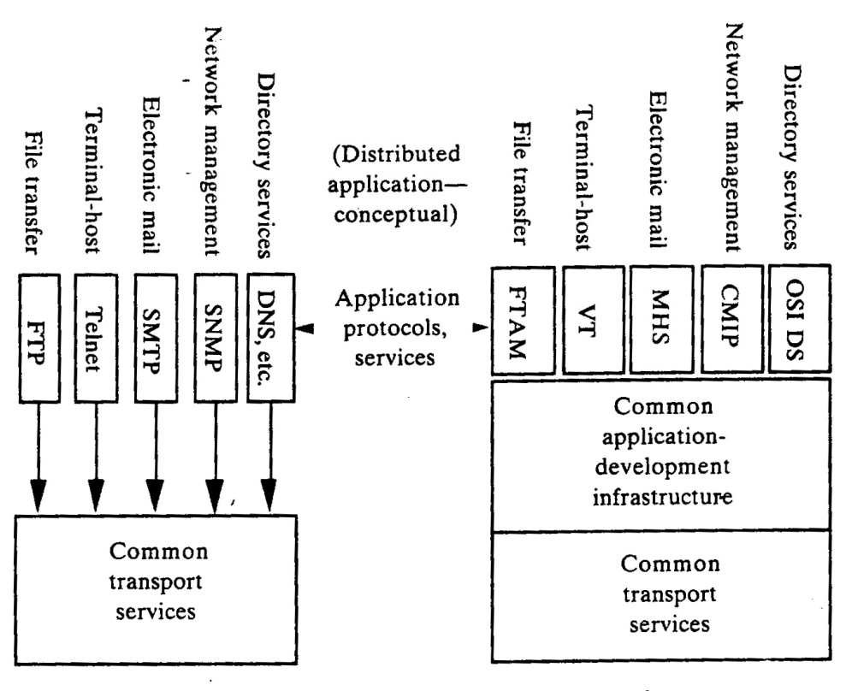
Approaches use in constructing application entities
The diagram below provides an overall view on the methods use by both the OSI and TCP/IP model.

Slide 10
ISO Approach
Sometime called Horizontal Approach
OSI asserts that distributed applications operate over a strict hierarchy of layers and are constructed from a common tool kit of standardized application service elements.
In OSI, each distributed application service selects functions from a large common “toolbox” of application service element (ASEs) and complements these with application service elements that perform functions specific to given end-user service .

Slide 11
TCP/IP Approach
Sometime called Vertical Approach
In TCP/IP, each application entity is composed of whatever set of function it needs beyond end to end transport to support a distributed communications service.
Most of these application processes builds on what it needs and assumes only that an underlying transport mechanism (datagram or connection) will be provided.

Slide 12
Transport Layer
OSI
TCP / IP
Transport (Layer 4)
Transport (TCP/UDP)
The functionality of the transport layer is to provide “transparent transfer of data from a source end open system to a destination end open system” (ISO / IEC 7498: 1984).

Slide 13
Transport Layer
Transport is responsible for creating and maintaining the basic end-to-end connection between communicating open systems, ensuring that the bits delivered to the receiver are the same as the bits transmitted by the sender; in the same order and without modification, loss or duplication

Slide 14
OSI Transport Layer
It takes the information to be sent and breaks it into individual packets that are sent and reassembled into a complete message by the Transport Layer at the receiving node
Also provide a signaling service for the remote node so that the sending node is notified when its data is received successfully by the receiving node

Slide 15
OSI Transport Layer
Transport Layer protocols include the capability to acknowledge the receipt of a packet; if no acknowledgement is received, the Transport Layer protocol can retransmit the packet or time-out the connection and signal an error

Slide 16
OSI Transport Layer
Transport protocols can also mark packets with sequencing information so that the destination system can properly order the packets if they’re received out-of-sequence
In addition, Transport protocols provide facilities for insuring the integrity of packets and requesting retransmission should the packet become garbled when routed.

Slide 17
OSI Transport Layer
Transport protocols provide the capability for multiple application processes to access the network by using individual local addresses to determine the destination process for each data stream

Slide 18
TCP/IP Transport Layer
Defines two standard transport protocols: TCP and UDP
TCP implements a reliable data-stream protocol
  connection oriented
UDP implements an unreliable data-stream
  connectionless

Slide 19
TCP/IP Transport Layer
TCP provides reliable data transmission
UDP is useful in many applications
  eg. Where data needs to be broadcasted or multicasted
Primary difference is that UDP does not necessarily provide reliable data transmission

Slide 20
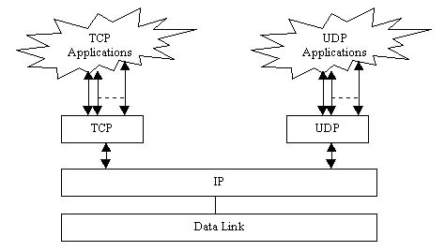
TCP/IP Transport Layer
Many programs will use a separate TCP connection as well as a UDP connection

Slide 21
TCP/IP Transport Layer
TCP is responsible for data recovery
  by providing a sequence number with each packet that it sends
TCP requires ACK (ackowledgement) to ensure correct data is received
Packet can be retransmitted if error detected

Slide 22
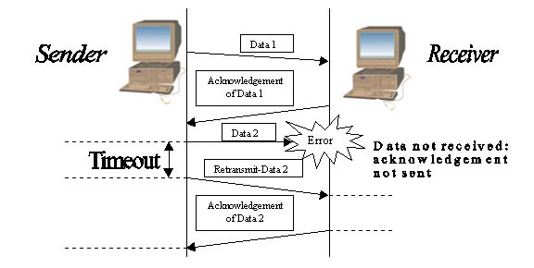
TCP/IP Transport Layer
Use of ACK

Slide 23
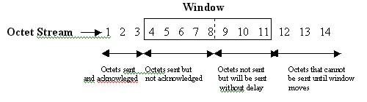
TCP/IP Transport Layer
Flow control with Window
  via specifying an acceptable range of sequence numbers

Slide 24
TCP/IP Transport Layer
TCP and UDP introduce the concept of ports
Common ports and the services that run on them:
        FTP 21 and 20
        telnet 23
        SMTP 25
        http 80
        POP3 110

Slide 25
TCP/IP Transport Layer
By specifying ports and including port numbers with TCP/UDP data, multiplexing is achieved
Multiplexing allows multiple network connections to take place simultaneously
The port numbers, along with the source and destination addresses for the data, determine a socket

Slide 26
Comparing Transport for both Models
The features of UDP and TCP defined at TCP/IP Transport Layer correspond to many of the requirements of the OSI Transport Layer. There is a bit of bleed over for requirements in the session layer of OSI since sequence numbers, and port values can help to allow the Operating System to keep track of sessions, but most of the TCP and UDP functions and specifications map to the OSI Transport Layer.

Slide 27
Comparing Transport for both Models
The TCP/IP and OSI architecture models both employ all connection and connectionless models at transport layer. However, the internet architecture refers to the two models in TCP/IP as simply “connections” and datagrams. But the OSI reference model, with its penchant for “precise” terminology, uses the terms connection-mode and connection-oriented for the connection model and the term connectionless-mode for the connectionless model.

Slide 28
Network vs. Internet
OSI
TCP / IP
Network (Layer 3)
Internet
Like all the other OSI Layers, the network layer provides both connectionless and connection-oriented services. As for the TCP/IP architecture, the internet layer is exclusively connectionless.

Slide 29
Network vs. Internet
X.25 Packet Level Protocol – OSI’s Connection-oriented Network Protocol
The CCITT standard for X.25 defines the DTE/DCE interface standard to provide access to a packet-switched network. It is the network level interface, which specifies a virtual circuit (VC) service. A source host must establish a connection (a VC) with the destination host before data transfer can take place. The network attempts to deliver packets flowing over a VC in sequence.

Slide 30
Network vs. Internet
Connectionless Network Service
  Both OSI and TCP/IP support a connectionless network service: OSI as an alternative to network connections and TCP/IP as the only way in use.
Internetworking Protocols
  OSI’s CLNP (ISO/IEC 8473: 1993) is functionally identical to the Internet’s IP (RPC 791). Both CLNP and IP are best-effort-delivery network protocols. Bit niggling aside, they are virtually identical. The major difference between the two is that CLNP accommodates variable-length addresses, whereas IP supports fixed, 32-bit address.

Slide 31
Network vs. Internet
Internet (IP) Addresses
  The lnternet network address is more commonly called the “IP address.” It consists of 32 bits, some of which are allocated to a high-order network-number part and the remainder of which are allocated to a low-order host-number part. The distribution of bits - how many form the network number, and how many are therefore left for the host number - can be done in one of three different ways, giving three different classes of IP address

Slide 32
Network vs. Internet
OSI Network Layer Addressing
  ISO/IEC and CCITT jointly administer the global network addressing domain. The initial hierarchical decomposition of the NSAP address is defined by (ISO/IEC 8348). The standard specifies the syntax and the allowable values for the high-order part of the address - the Initial Domain Part (IDP), which consists of the Authority and Format Identifier (AFI) and the Initial Domain Identifier (IDI) - but specifically eschews constraints on or recommendations concerning the syntax or semantics of the domain specific part (DSP).

Slide 33
Network vs. Internet
OSI Routing Architecture
  End systems (ESs) and intermediate systems (ISs) use routing protocols to distribute (“advertise”) some or all of the information stored in their locally maintained routing information base. ESs and ISs send and receive these routing updates and use the information that they contain (and information that may be available from the local environment, such as information entered manually by an operator) to modify their routing information base.

Slide 34
Network vs. Internet
TCP/IP Routing Architecture
  The TCP/IP routing architecture looks very much like the OSI routing architecture. Hosts use a discovery protocol to obtain the identification of gateways and other hosts attached to the same network (subnetwork). Gateways within autonomous systems (routing domains) operate an interior gateway protocol (intradomain IS-IS routing protocol), and between autonomous systems, they operate exterior or border gateway protocols (interdomain routing protocols). The details are different but the principles are the same.

Slide 35
Data link / Physical vs. Subnet
OSI
TCP / IP
Data Link (Layer 2)
Subnet
Physical (Layer 1)
Data link layer
  The function of the Data Link Layer is “provides for the control of the physical layer, and detects and possibly corrects errors which may occur” (IOS/IEC 7498:1984). In another words, the Data Link Layer transforms a stream of raw bits (0s and 1s) from the physical into a data frame and provides an error-free transfer from one node to another, allowing the layers above it to assume virtually error-free transmission

Slide 36
Data link / Physical vs. Subnet
Physical layer
  The function of the Physical Layer is to provide “mechanical, electrical, functional, and procedural means to activate a physical connection for bit transmission” (ISO/IEC 7498:1984). Basically, this means that the typical role of the physical layer is to transform bits in a computer system into electromagnetic (or equivalent) signals for a particular transmission medium (wire, fiber, ether, etc.)

Slide 37
Data link / Physical vs. Subnet
Comparing to TCP/IP
  These 2 layers of the OSI correspond directly to the subnet layer of the TCP/IP model.
  Majority of the time, the lower layers below the Interface or Network layer of the TCP/IP model are seldom or rarely discussed. The TCP/IP model does nothing but to high light the fact the host has to connect to the network using some protocol so it can send IP packets over it. Because the protocol used is not defines, it will vary from host to host and network to network

Slide 38
Data link / Physical vs. Subnet
Comparing to TCP/IP
  After much deliberation by organizations, it was decided that the Network Interface Layer in the TCP/IP model corresponds to a combination of the OSI Data Link Layer and network specific functions of the OSI network layer (eg IEEE 203.3).
  Since these two layers deal with functions that are so inherently specific to each individual networking technology, the layering principle of grouping them together related functions is largely irrelevant.

Slide 39
General Comparison
Focus of Reliability Control
Roles of Host System
De-jure vs. De-facto

Slide 40
Focus of Reliability Control
Implementation of the OSI model places emphasis on providing a reliable data transfer service, while the TCP/IP model treats reliability as an end-to-end problem.
Each layer of the OSI model detects and handles errors, all data transmitted includes checksums. The transport layer of the OSI model checks source-to-destination reliability.
In the TCP/IP model, reliability control is concentrated at the transport layer. The transport layer handles all error detection and recovery. The TCP/IP transport layer uses checksums, acknowledgments, and timeouts to control transmissions and provides end-to-end verification.

Slide 41
Roles of Host System
Hosts on OSI implementations do not handle network operations (simple terminal), but TCP/IP hosts participate in most network protocols. TCP/IP hosts carry out such functions as end-to-end verification, routing, and network control. The TCP/IP internet can be viewed as a data stream delivery system involving intelligent hosts.

Slide 42
De-jure vs. De-facto (OSI)
OSI
  Standard legislated by official recognized body. (ISO)
  The OSI reference model was devised before the protocols were invented. This ordering means that the model was not biased toward one particular set of protocols, which made it quite general. The down side of this ordering is that the designers did not have much experience with the subject and did not have a good idea of which functionality to put in which layer.
  Being general,the protocols in the OSI model are better hidden than in the TCP/IP model and can be replaced relatively easily as the technology changes.
  Not so widespread as compared with TCP/IP. (complex , costly)
  More commonly used as teaching aids.

Slide 43
De-jure vs. De-facto (TCP/IP)
TCP/IP
  Standards adopted due to widespread use. (Internet)
  The protocols came first, and the model was really just a description of the existing protocols. There was no problem with the protocols fitting the model, but it is hardly possible to be use to describe other models.
  “Get the job done" orientation.
  Over the years it has handled most challenges by growing to meet the needs.
  More popular standard for internetworking for several reasons :
    relatively simple and robust compared to alternatives such as OSI
    available on virtually every hardware and operating system platform (often free)
    the protocol suite on which the Internet depends.

